Slide 1
What sustain life on earth?

Slide 2
Environment and Ecosystem
What sustain life on earth?
Components of Earth
Flow of high-quality (Usable) energy from the sun
Cycling of matter or nutrients needed for survival.
Gravity

Slide 3
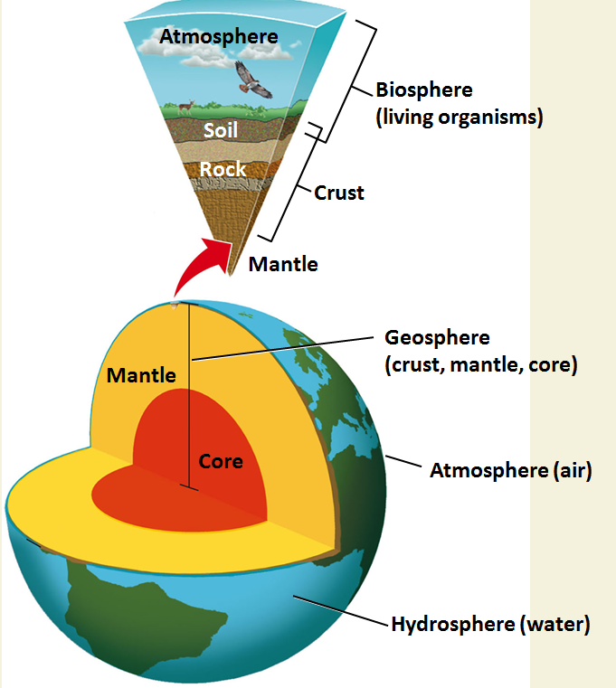
Components of the Earth

Slide 4
Composition of Earth's Atmosphere
Components
Major and constant Minor and Variable
Essential to life on the planet (Major)
Impact on weather and other atmospheric processes(Minor)
Without GHGs Earth's surface would be about 30⁰C cooler
Nitrogen | 78.08%​
Oxygen | 20.95%​
Argon | 0.93%​
Neon, Helium, Krypton | 0.0001%​
Carbon dioxide | 0.038%​
Water vapor | 0-4%​
Methane | trace​
Sulfur dioxide | trace​
Ozone | trace​
Nitrogen oxides (NO, NO₂, N₂0) | trace

Slide 5
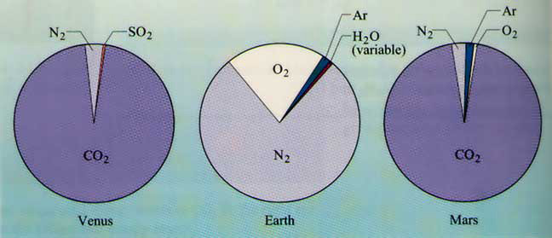
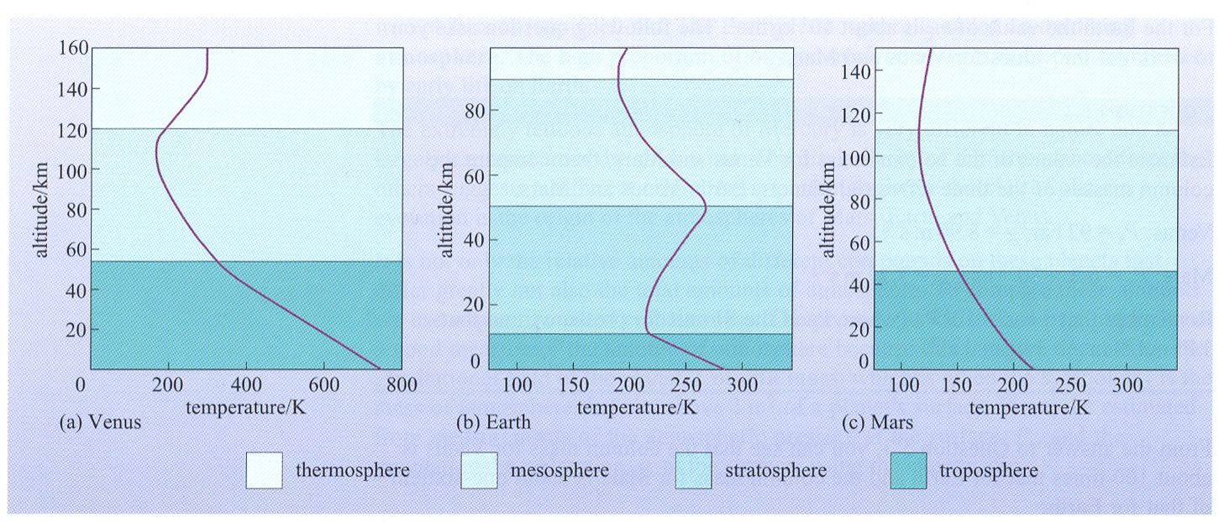
A Comparison

Slide 6
STRUCTURE AND COMPOSITION OF THE ATMOSPHERE
The atmosphere is conveniently classified using 3 criteria:
Composition
Temperature
Function.

Slide 7
CHEMICAL COMPOSITION
Heterosphere
Gases are not evenly mixed but assorted by gravity according to their atomic weight and reaction of the gases with solar radiation
Homosphere.
Density of air changes with altitude but the proportion of gases is nearly uniform
contains aproximately 78% nitrogen, 21% oxygen and about 1% a mixture of other gases including argon, carbon dioxide, neon, helium, methane, krypton, hydrogen, dinitrogen monoxide, carbon monoxide, xenon, and ozone by volume.

Slide 8
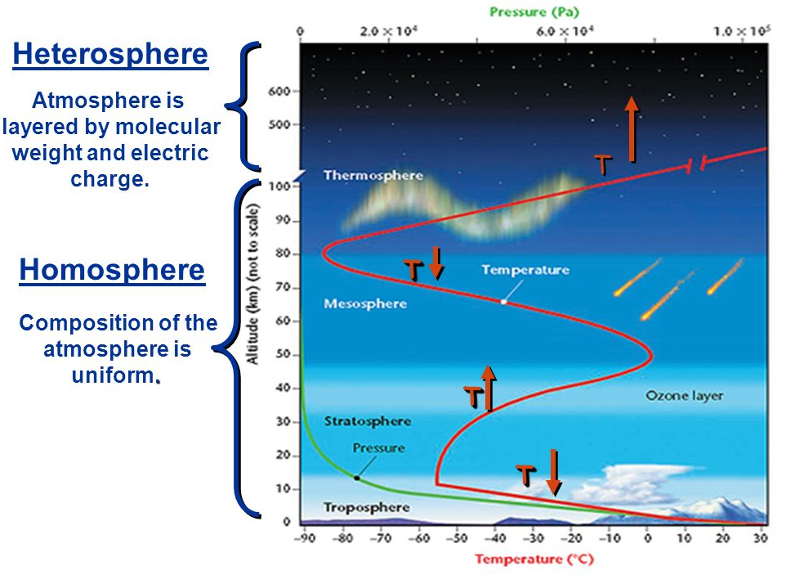
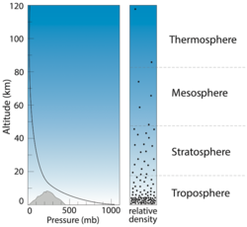
CHEMICAL COMPOSITION
Less than 0.001% of the mass of the earth’s atmosphere is in the heterosphere.

Slide 9
TEMPERATURE
Within the troposphere, temperature decreases with altitude (positive lapse rate) at a rate of about 6.5° C per kilometre
By absorbing UV rays, the ozone layer in stratosphere warms the air around it(negative lapse rate)
In mesosphere, temperature decreases due to the rapidly decreasing density of the air at this altitude
In thermosphere ,intense, unfiltered radiation from the sun causes molecules like O₂ and N₂ to break apart into ions. The release of energy from these reactions actually causes the temperature to rise

Slide 10
FUNCTION
Based on function, the atmosphere has 2 zones that remove harmful solar radiation and charged particles:
Ionosphere
extends throughout the thermosphere into the mesosphere.
absorbs Cosmic rays, gamma rays, X-rays and Ultraviolet radiation.
Ozonosphere
a layer of ozone gas
absorbs 97 to 99 % of the Sun's medium-frequency ultraviolet light .

Slide 11
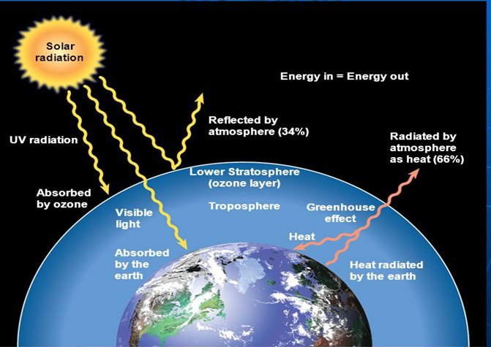
Flow of Energy to and from the Earth

Slide 12
Flow of energy to Sustain Life on Earth
flow of high-quality energy:
Sun → plants → living things → environment as heat → radiation to space

Slide 13

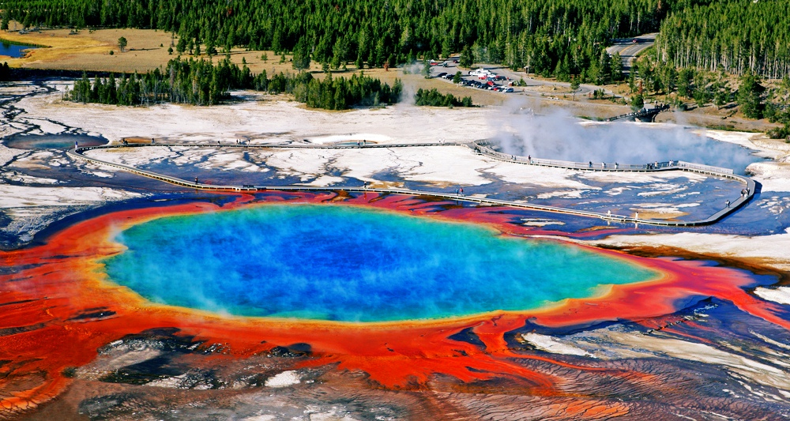
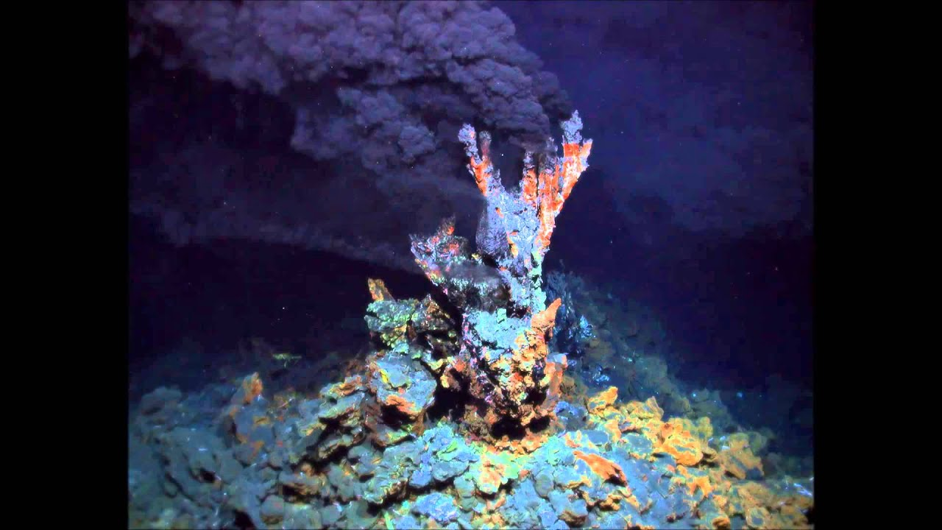
Source of energy

Slide 14
Source of energy
Ecosystems depend upon the ability of some organisms to convert inorganic compounds into food.
Photosynthesis - source of energy – Sunlight
6CO₂ + 12H₂O + Light Energy → C₆H₁₂O₆ + 6O₂ + 6H₂O(oxygenic)
CO₂ + 2H₂S + Light Energy → [CH₂O] + 2S + H₂O(anoxygenic)
Chemosynthesis - source of energy – chemicals
12H₂S + 6CO₂ → C₆H₁₂O₆ (Glucose) + 6H₂O + 12S

Slide 15
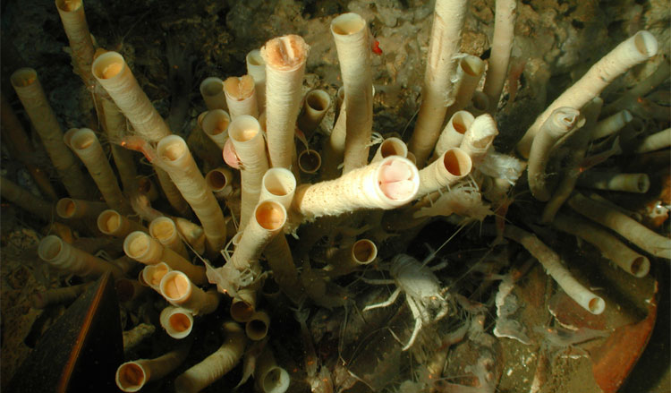
Chemosynthesis
a tubeworm “bush,” which mines for sulfide in the carbonate substrate with their roots.

Slide 16
Chemosynthetic Bacteria in Hydrothermal Vents
Hydrothermal vents are fissures in the deep ocean crust where super-heated lava and magma seep, releasing dissolved chemicals when coming in contact with the deep ocean’s cold water
located very deep into the ocean
Examples:
nitrifying bacteria, sulfur-oxidizing bacteria, sulfur-reducing bacteria, iron-oxidizing bacteria, halobacterium etc

Slide 17
Chemosynthesis and Photosynthesis
1.) Where does the energy to fuel this process come from?
2.) What kind of cells are the factory for this process?
3.) What kind of food is produced in this process?
4.) What gets sent out into the environment by the organism at the end of the process?

Slide 18
Similarities……
Needs carbon dioxide to produce the carbohydrates
needs an energy source to fuel the reactions
result in food for the organisms-supporting the circle of life.

Slide 19
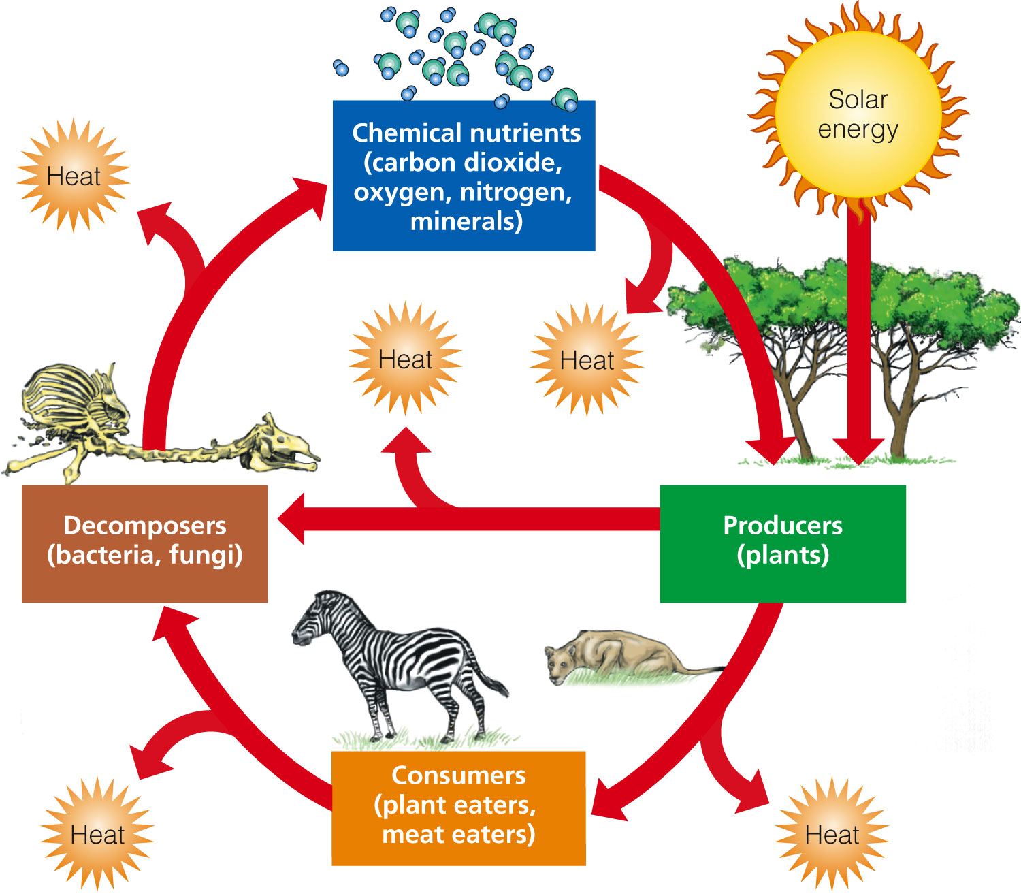
Components of Ecosystem

Slide 20
Ecological Productivity
Productivity(kg m^{–2} day^{–1})the rate of generation of biomass in an ecosystem
Primary Production
Primary production describes the production of chemical energy in organic compounds by producers
The main source of energy for primary production is sunlight, but a fraction may be driven by chemosynthesis

Slide 21
Primary Productivity
Some Ecosystems Produce Plant Matter Faster Than Others Do
Gross primary productivity (GPP)
Rate at which an ecosystem’s producers convert solar energy to chemical energy and biomass
Net primary productivity (NPP)
Rate at which an ecosystem’s producers convert solar energy to chemical energy, minus the rate at which producers use energy for aerobic respiration
Ecosystems and life zones differ in their NPP

Slide 22
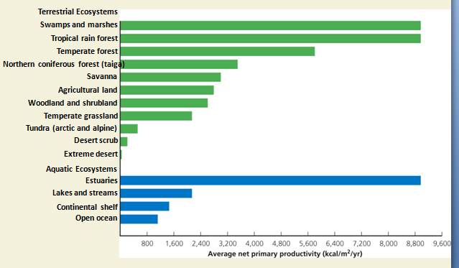
Estimated Annual Average NPP in Major Life Zones and Ecosystems

Slide 23
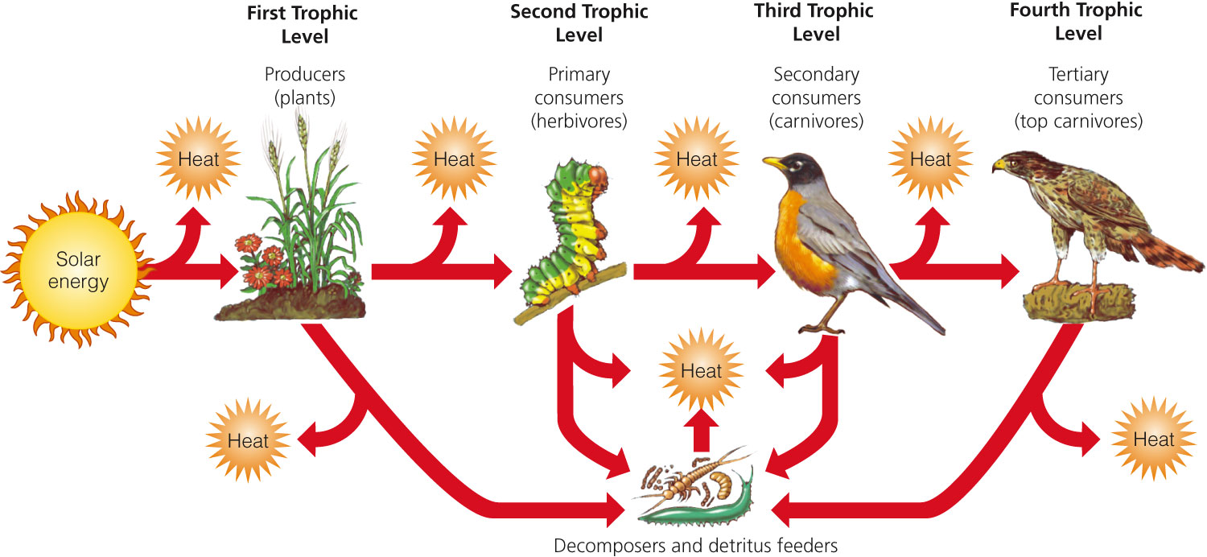
What Happens to Energy in an Ecosystem?
As energy flows through ecosystems in food chains and webs, the amount of chemical energy available to organisms at each succeeding feeding level decreases

Slide 24
Energy transfer through food chain and food web not very energy efficient-as usuable chemical energy in every stage is degraded and lost as low quality energy (Heat)
Very low chemical energy is available after 4 or 5 tropic level transfer
Less no of higher tropic level organism than lower tropic level organism

Slide 25
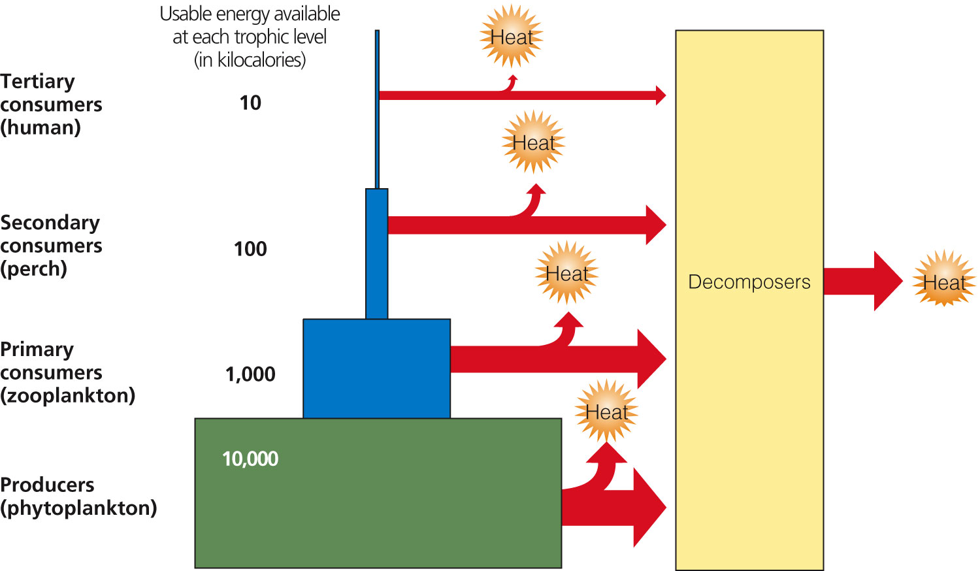
Pyramid of Energy Flow
ie.vegetarian diet is more energy efficient than a meat-based diet

Slide 26
Nutrients Cycles
What Happens to Matter in an Ecosystem?
Matter in the form of nutrients, cycles within and among ecosystems and the biosphere
Human activities are altering these chemical cycles.

Slide 27
Nutrients Cycle in the Biosphere
Biogeochemical cycles, nutrient cycles
Hydrologic
Carbon
Nitrogen
Phosphorus
Sulfur

Slide 28
Hydrologic Cycle
Natural renewal of water quality: three major processes
Evaporation
Precipitation
Transpiration
Alteration of the hydrologic cycle by humans
Withdrawal of large amounts of freshwater at rates faster than nature can replace it
Clearing vegetation
Increased flooding when wetlands are drained

Slide 29
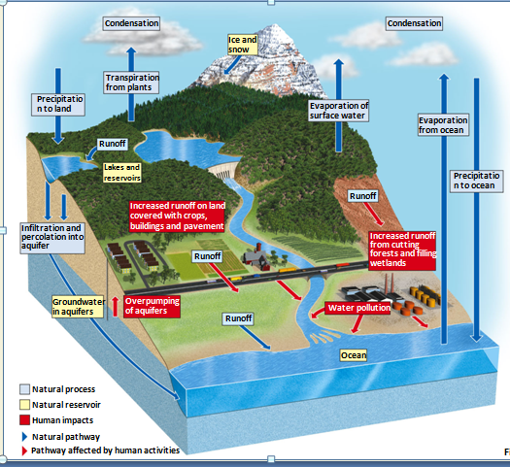
Hydrologic Cycle Including Harmful Impacts of Human Activities

Slide 30
Carbon Cycle
Carbon Cycle Depends on Photosynthesis and Respiration
Additional CO₂ added to the atmosphere
Tree clearing
Burning of fossil fuels
Warms the atmosphere

Slide 31
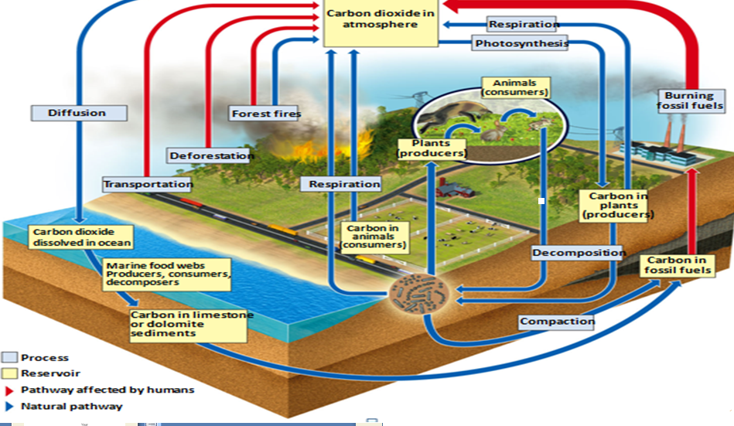
Carbon Cycle with Major Harmful Impacts of Human Activities

Slide 32
Nitrogen Cycles
Nitrogen Cycles through the Biosphere
Nitrogen fixed by lightning
Nitrogen fixed by bacteria and cyanobacteria
Combine gaseous nitrogen with hydrogen to make ammonia (NH₃) and ammonium ions (NH₄⁺)
Nitrification
Soil bacteria change ammonia and ammonium ions to nitrate ions (NO₃⁻)
Denitrification
Nitrate ions back to nitrogen gas

Slide 33
Nitrogen Cycles
Human intervention in the nitrogen cycle
Additional NO and N₂O in atmosphere from burning fossil fuels; also causes acid rain
N₂O to atmosphere from bacteria acting on fertilizers and manure
Destruction of forest, grasslands, and wetlands
Add excess nitrates to bodies of water
Remove nitrogen from topsoil

Slide 34
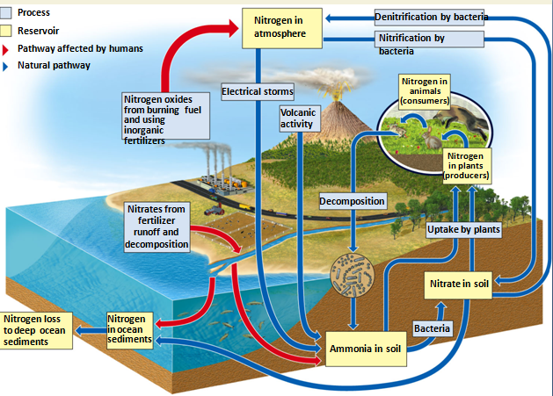
Nitrogen Cycles

Slide 35
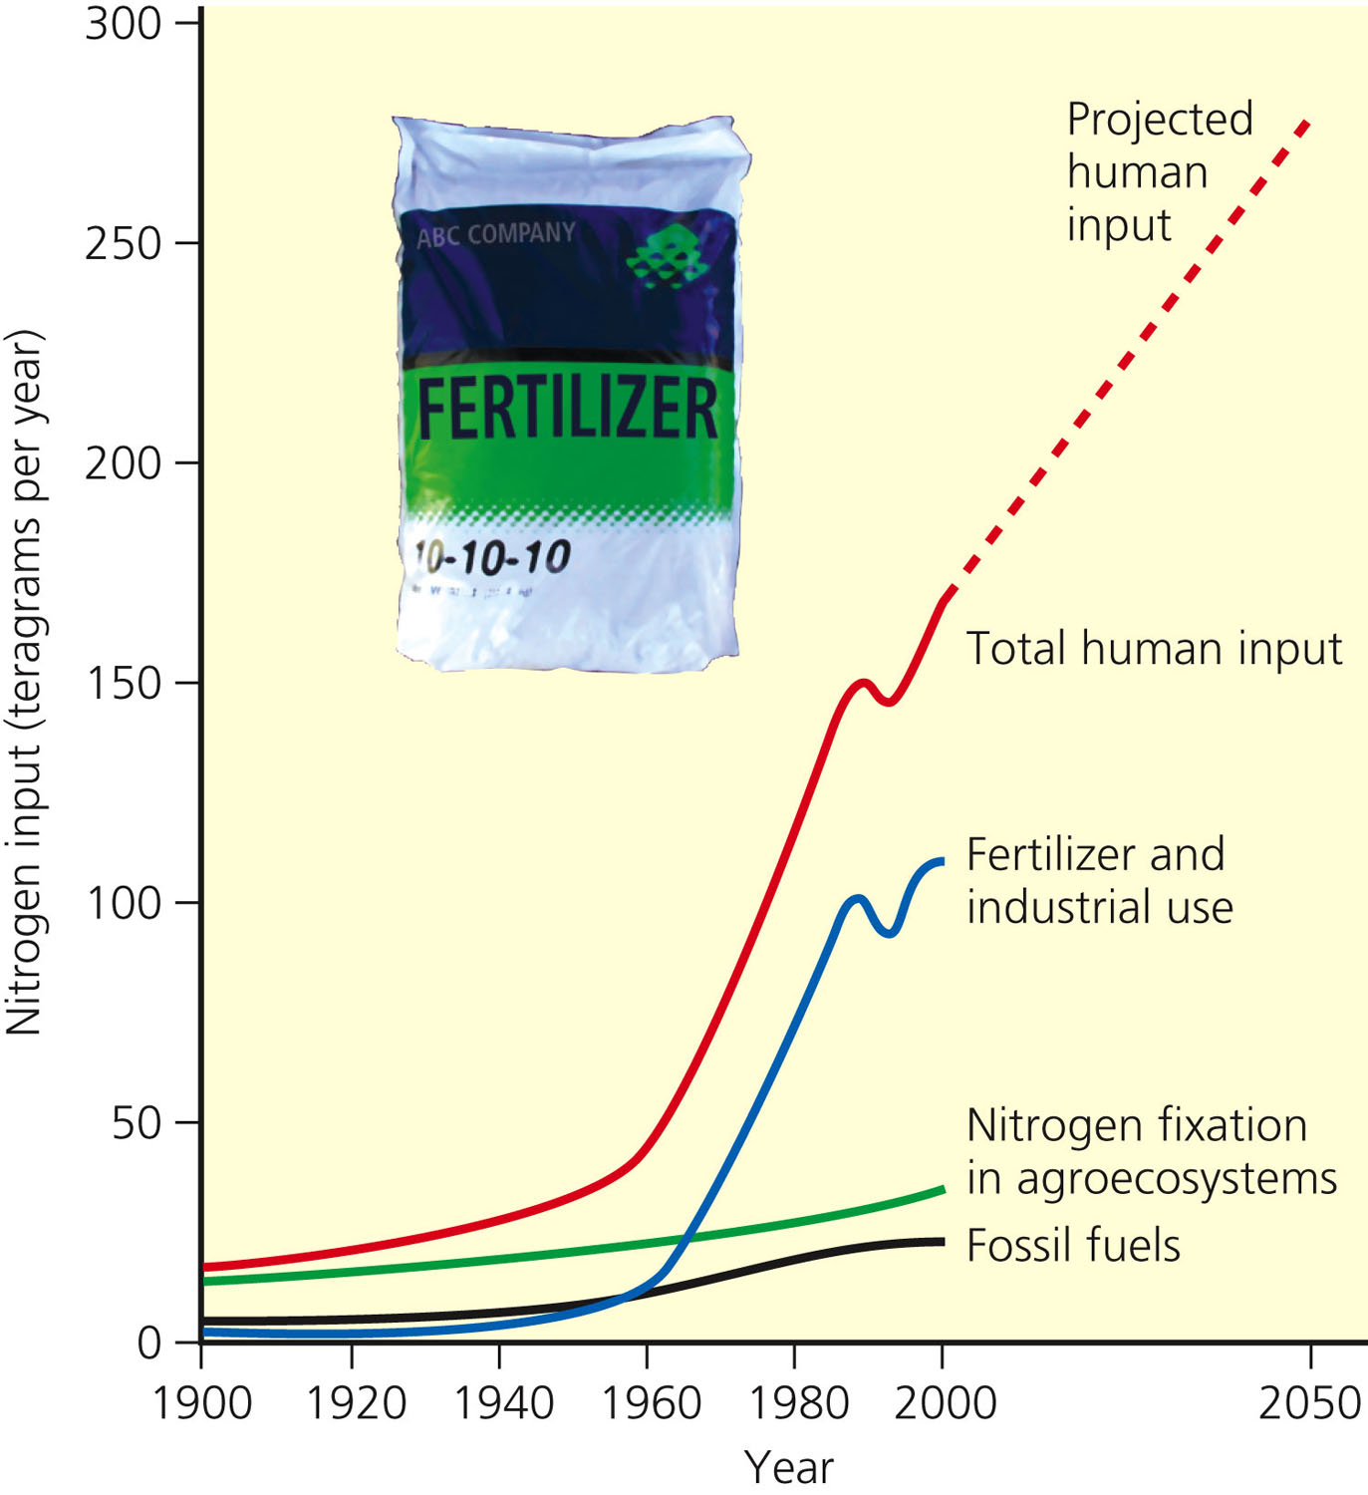
Human Input of Nitrogen into the Environment

Slide 36
Phosphorus Cycles
Cycles through water, the earth’s crust, and living organisms
Limiting factor for plant growth
Impact of human activities
Clearing forests
Removing large amounts of phosphate from the earth to make fertilizers
Erosion leaches phosphates into streams

Slide 37
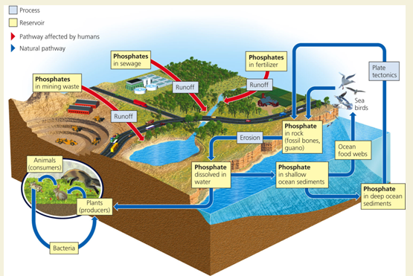
Phosphorus Cycles

Slide 38
Sulfur Cycles
Sulfur found in organisms, ocean sediments, soil, rocks, and fossil fuels
SO₂ in the atmosphere
H₂SO₄ and SO₄⁻
Human activities affect the sulfur cycle
Burn sulfur-containing coal and oil
Refine sulfur-containing petroleum
Convert sulfur-containing metallic mineral ores

Slide 39
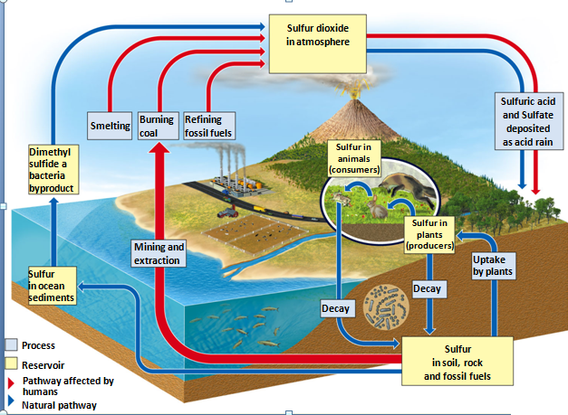
Sulfur Cycles

